Slide 1

Kig under vandet GEUS
Update: 21/6/2023

Slide 2
Havbundens overfladesedimenter
“Det er et geologisk kort, der hovedsageligt er baseret på seismiske og akustiske baggrundsdata kalibreret ud fra sedimentprøver.”
“Klassifikationerne på kortet er et udtryk for et gennemsnit af havbundens sedimenter i de øverste ca. 0,50 m.”
https://www.geus.dk/mineralske-raastoffer/raastoffer-i-danmark/havbundens-overfladesedimenter

Slide 3
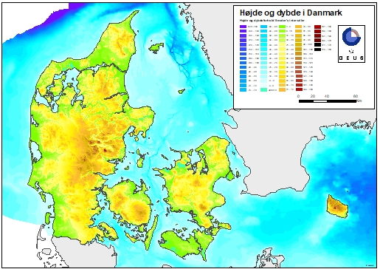
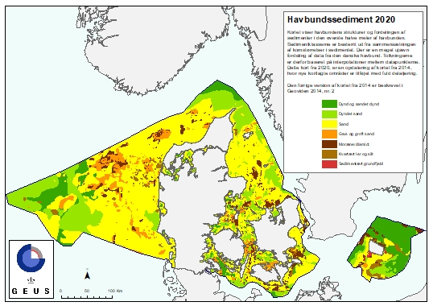
Standard maps from geus

Slide 4

Video and image data
Link to request videos. Change ID to get another video. Video information is given visual or audio throughout video.
Example: https://data.geus.dk/geusmapmore/marta/info_marta_getfile.jsp?iContents=video&iID=1651
Video length: Min: 2:41, max: 19:00
Script made to download all video and image files: “download_files.py

Slide 5
Classifications
Super classes
Stenbund / stenet havbund / hårdbund / stenrev
Sandbund
Ribber
Bobbelrev
Sub classes
Mindre sten
Store sten
Enkelt sten
XX% stendække
Variende stenstørrelse
Spredte sten
Overgang fra sten til sandbund
Vegetation
Palmaria
Polysiphonia
…
NST Substrattype
Sand
??
Sandribber, Svovlbakterier, Iltsvind
Moræne/diamict, Sand, Grus og groft sand
Moræne/diamict
Very confusion as there are so many specific and broad descriptions.
Spelling mistakes “stewnbund”, subjective verbs “flotte”

Slide 6
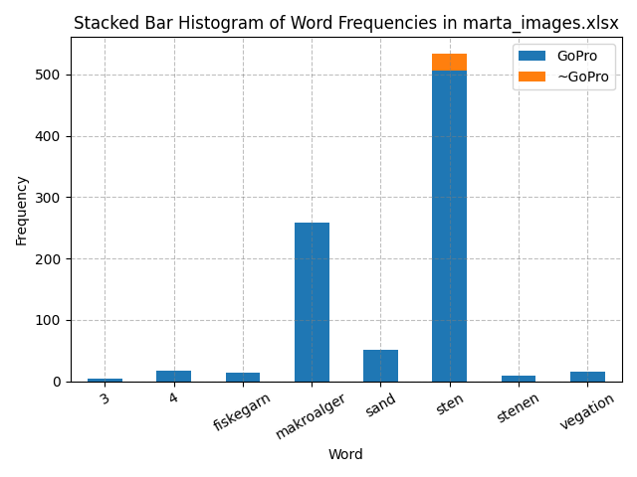
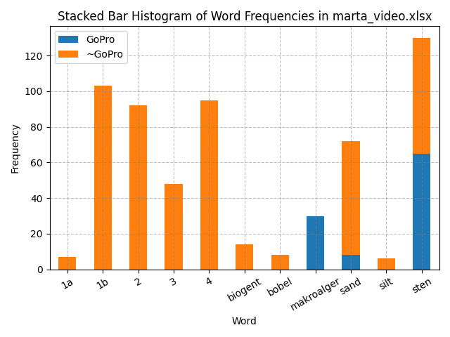
File: marta_images.xlsx
With sum: 869 nan=3890 (rm words=143)
Without sum: 27 nan=339 (rm words=23)
Total sum: 5291 / 6027 nan=4229
Note: All images starts with "G-” (indicates GoPro)
File: marta_video.xlsx
With sum: 103 nan=542 (rm words=32)
Without sum: 502 nan=41 (rm words=27)
Total sum: 1247 / 1236 nan=583

Slide 7
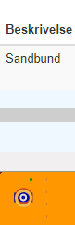
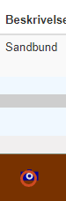
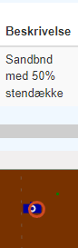
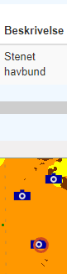

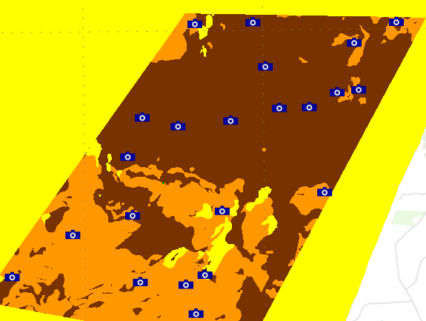
sediment map & Classifications ??

Slide 8
WMS / WFS get data using GIS client
Could not get working with the arcgis API. https://developers.arcgis.com
JavaScript will get data map https://developers.arcgis.com/javascript/latest/display-a-map/
Python request can get data to XML file - But??
https://data.geus.dk/geusmap/ows/help/index.jsp?nocache=nocache&whoami=130.226.217.170&mapname=marta&layers=marta_video&epsg=25832&lang=en

Slide 9
Sonar data?
“geusmap” → “Lines” → “Data for download”: “SKAGERRAK_2000.DAT”, “GRIBBEN_1997.TRA”
TRA and DAT files. Lines from the map downloaded by a link retrieved through e-mail by sign up.
IS THIS SONAR DATA AND WHERE THEY HAVE BEEN?
Can’t figure out how to open TRA and DAT files.
http://data.geus.dk/webupload/geusmap/d2639f09-c9e5-462d-b688-7ef7339669c2.zip

